Slide 1
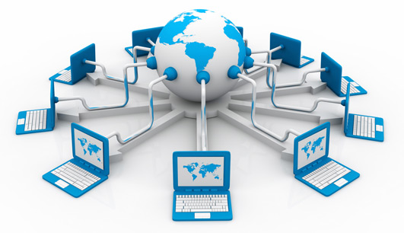
Introduction to Web Technology

Slide 2
What is Internet?
The Internet is a massive network of networks. It connects millions of computers together globally, forming a network in which any computer can communicate with any other computer as long as they are both connected to the Internet.
The Internet is simply a public access Wide Area Network, linking several million computers around the world. The Internet, or Information Superhighway, is the backbone which links together a huge range of information resources such as new services, corporate catalogues, bulletin boards and library archives, that can be delivered directly to the user’s desktop. As an example, an Internet user in Malaysia can log onto machines and servers in America or Australia, in order to browse and download information on millions of topics.
There are various ways that users can access this information, but the most popular and user friendly way is to use the World Wide Web. There are thousands of Web Servers on the Internet, each one presenting users with formatted ‘pages’ of text, sound and graphic based information. Using what is referred to as a Web browser, users can navigate this World Wide Web of linked information, using a ‘point and click’ windows based graphical user interface.

Slide 3
What is Intranet?
Rather than viewed as competition to the Internet, an Intranet can be viewed quite simply as a private internal company Internet.
If we think of the Internet as an open public service, an Intranet is an organization’s private version of it, i.e. information contained in a hypermedia based format, but only available to people within the organization rather than millions of users around the world.
When a company invests in an Intranet, its users have access to internal on­line data in a Web based environment.
By using a browser a user can search through the contents of the company’s Intranet. This means that information becomes on-line, making it easier to distribute, update and obtain and replaces the need to distribute large amounts of paper

Slide 4
What is World Wide Web (www)?
The World Wide Web, or simply Web, is a way of accessing information over the medium of the Internet.
It is an information-sharing model that is built on top of the Internet.
The Web utilizes browsers, such as Internet Explorer or Firefox, to access Web documents called Web pages that are linked to each other via hyperlinks.
Web documents also contain graphics, sounds, text and video.

Slide 5
HTML, CSS & JavaScript
These are the three main building blocks of every website.
HTML
HTML is responsible for the structure of the site, CSS sets the styles, and interactive functionalities are implemented using JavaScript.
Every webpage is built on an HTML code. To check the HTML code of the current page press Ctrl + U and you will see a structured code using so-called tags to define the elements. We can specify what is a header, a link, a paragraph on our page using tags.
CSS
Thanks to CSS we can design nice-looking unique websites, setting colors, margins, borders, heights, font styles, background images etc. It's not necessary to use a stylesheet but without it every website would look the same, having black text on a white background, with blue links.
JavaScript
JavaScript is a program which is downloaded from the web server and runs on the client-side, which means that it's executed in the web browser. It is used to animate image galleries, to validate form fields before submission, to manage cookies, to bring dropdown menus to life etc.

Slide 6
What is Web Browser?
A Web browser is a program that allows you to interact and view the internet and contents of the Web.
The Web browser is the program you are using while browsing the Internet.
You just type in a URL (web link) in the address bar and the browser renders the website on your screen.
The most popular browsers are Google Chrome from Google, Firefox open source browser by Mozzilla, Safari from Apple, and Internet Explorer / Edge from Microsoft.
These have both PC and mobile versions.

Slide 7
URL, URI and URN
A Uniform Resource Locator (URL), colloquially termed a web address,^{[1]} is a reference to a web resource that specifies its location on a computer network and a mechanism for retrieving it.
Gopinathan Munappy
URIs identify and URLs locate; however, locators are also identifiers, so every URL is also a URI, but there are URIs which are not URLs.
This is my name, which is an identifier. It is like a URI, but cannot be a URL, as it tells you nothing about my location or how to contact me. In this case it also happens to identify at least 5 other people in the USA alone.
4914 West Bay Street, Nassau, Bahamas
This is a locator, which is an identifier for that physical location. It is like both a URL and URI (since all URLs are URIs), and also identifies me indirectly as "resident of..". In this case it uniquely identifies me, but that would change if I get a roommate.

Slide 8
URI -- Uniform Resource Identifier
URIs are a standard for identifying documents using a short string of numbers, letters, and symbols. They are defined by RFC 3986.
URL -- Uniform Resource Locator
Contains information about how to fetch a resource from its location. For example:
http://example.com/mypage.html
ftp://example.com/download.zip
URLs always start with a protocol (http) and usually contain information such as the network host name (example.com) and often a document path (/foo/mypage.html). URLs may have query parameters and fragment identifiers.
URN -- Uniform Resource Name
Identifies a resource by a unique and persistent name, but doesn't necessarily tell you how to locate it on the internet. It usually starts with the prefix urn: For example:
urn:isbn:0451450523 to identify a book by its ISBN number.
urn:uuid:6e8bc430-9c3a-11d9-9669-0800200c9a66 a globally unique identifier
URNs can identify ideas and concepts. They are not restricted to identifying documents.

Slide 9
What is Web Server?
A web server is a computer that runs websites. It's a computer program that distributes web pages as they are requisitioned.
A Web server handles the HTTP protocol. When the Web server receives an HTTP request, it responds with an HTTP response, such as sending back an HTML page. To process a request, a Web server may respond with a static HTML page or image, send a redirect, or delegate the dynamic response generation to some other program such as CGI scripts, JSPs (JavaServer Pages), servlets, ASPs (Active Server Pages), server-side JavaScripts, or some other server-side technology. Whatever their purpose, such server-side programs generate a response, most often in HTML, for viewing in a Web browser.
The basic objective of the web server is to store, process and deliver web pages to the users. This intercommunication is done using Hypertext Transfer Protocol (HTTP). These web pages are mostly static content that includes HTML documents, images, style sheets, test etc. Apart from HTTP, a web server also supports SMTP (Simple Mail transfer Protocol) and FTP (File Transfer Protocol) protocol for emailing and for file transfer and storage.
When you try to access a site you basically send a request to a web server to serve you with the content for that specific URL.

Slide 10
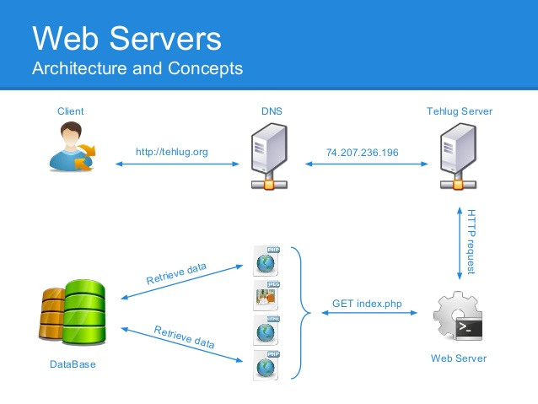
Web Server and Architecture

Slide 11
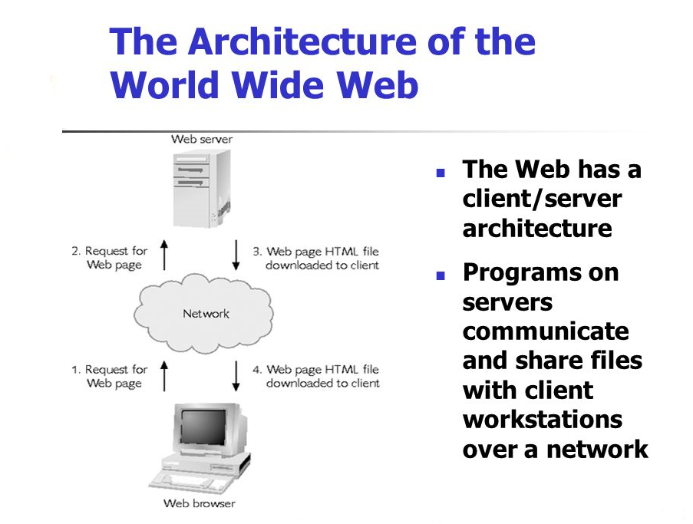

Slide 12
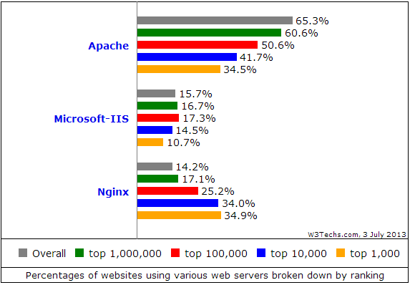
Popular Web servers

Slide 13
What is an application server?
An application server is a component-based product that resides in the middle-tier of a server centric architecture.
It provides middleware services for security and state maintenance, along with data access and persistence.
Java application servers are based on the Java™ Platform, Enterprise Edition (JEE™).
J2EE uses a multi-tier distributed model.
This model generally includes a Client Tier, a Middle Tier, and an EIS Tier.
The Client Tier can be one or more applications or browsers. The JEE Platform is in the Middle Tier and consists of a Web Server and an EJB Server. (These servers are also called "containers.") There can be additional sub-tiers in the middle tier.
The Enterprise Information System (EIS) tier has the existing applications, files, and databases.
For the storage of business data, the J2EE platform requires a database that is accessible through the JDBC, SQLJ, or JDO API.
The database may be accessible from web components, enterprise beans, and application client components.

Slide 14
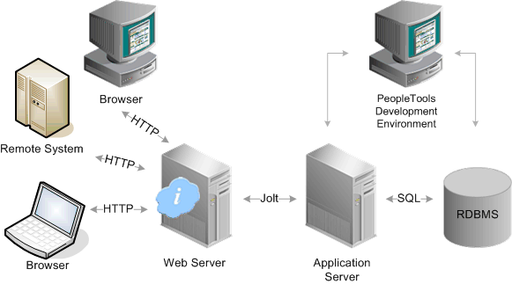

Slide 15
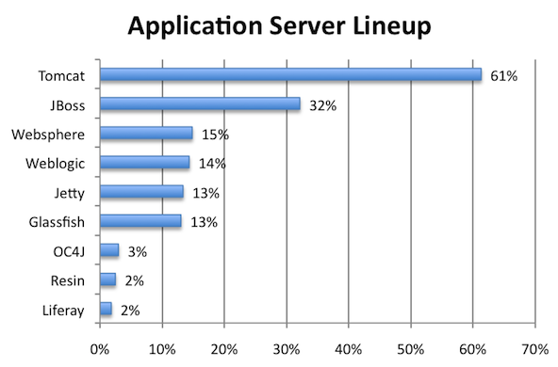

Slide 16
What is Domain Name?
Domain names are used to identify one or more IP addresses. For example, the domain name microsoft.com represents about a dozen IP addresses. Domain names are used in URLs to identify particular Web pages.
For example, in the URL http://www.google.com/index.html, the domain name is google.com.
Every domain name has a suffix that indicates which top level domain (TLD) it belongs to. There are only a limited number of such domains. For example:
gov - Government agencies
edu - Educational institutions
org - Organizations (nonprofit)
mil - Military
com - commercial business
net - Network organizations
ca - Canada
th – Thailand
Because the Internet is based on IP addresses, not domain names, every Web server requires a Domain Name System (DNS) server to translate domain names into IP addresses.

Slide 17
What is HTTP?
Hypertext Transfer Protocol, HTTP is a set of standards that allow users of the World Wide Web to exchange information found on web pages.
When accessing any web page entering http:// in front of the address tells the browser to communicate over HTTP.
For example, the URL for Computer Hope is https://www.computerhope.com.
Today's browsers no longer require HTTP in front of the URL since it is the default method of communication.
However, it is kept in browsers because of the need to separate protocols such as FTP.
Below are a few of the major facts on HTTP.
The term HTTP was coined by Ted Nelson.
The standard port for HTTP connections is port 80.
HTTP/0.9 was the first version of the HTTP, and was introduced in 1991.
HTTP/1.0 is specified in RFC 1945, and was introduced in 1996.
HTTP/1.1 is specified in RFC 2616, and was officially released in January 1997.
.

Slide 18
What is HTTPS?
HTTPS
Short for Hypertext Transfer Protocol Secure, HTTPS is a protocol which uses HTTP on a connection encrypted by transport-layer security. HTTPS is used to protect transmitted data from eavesdropping. It is the default protocol for conducting financial transactions on the web, and can protect a website's users from censorship by a government or an ISP.
HTTPS uses port 443 to transfer its information.
HTTPS is first used in HTTP/1.1 and is defined in RFC 2616.
HTTP status codes
404Below is a listing of HTTP status codes currently defined by Computer Hope. These codes enable a client accessing another computer or device over HTTP to know how to proceed or not proceed. For example, 404 tells the browser the request does not exist on the server.
.

Slide 19
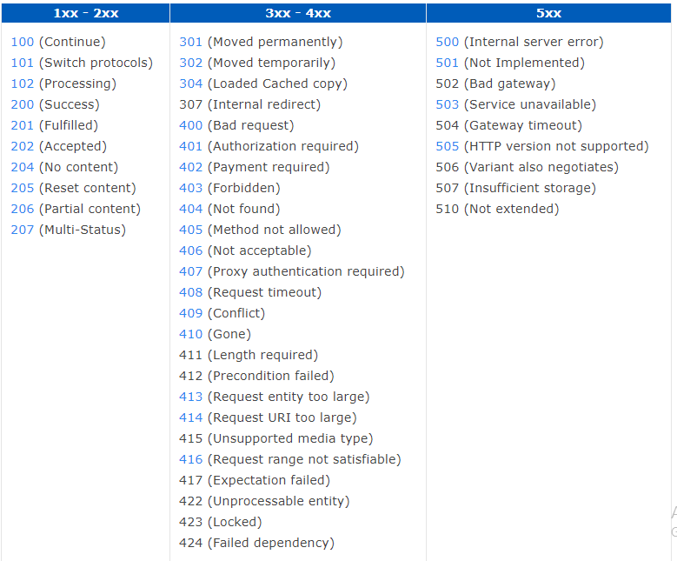
HTTP status codes

Slide 20
What is an IP Address?
An IP address, short for Internet Protocol address, is an identifying number for a piece of network hardware. Having an IP address allows a device to communicate with other devices over an IP-based network like the internet.’
Most IP addresses look like this:
151.101.65.121
What Is an IP Address Used For?
An IP address provides an identity to a networked device. Similar to a home or business address supplying that specific physical location with an identifiable address, devices on a network are differentiated from one another through IP addresses.
If I'm going to send a package to my friend in another country, I have to know the exact destination. It's not enough to just put a package with his name on it through the mail and expect it to reach him. I must instead attach a specific address to it, which you could do by looking it up in a phone book.
This same general process is used when sending data over the internet. However, instead of using a phone book to look up someone's name to find their physical address, your computer uses DNS servers to look up a hostname to find its IP address.
For example, when I enter a website like www.lifewire.com into my browser, my request to load that page is sent to DNS servers that look up that hostname (lifewire.com) to find its corresponding IP address (151.101.65.121).

Slide 21
Client And Server Side
We have to distinguish client and server side operations.
Server-side code runs on the server, using languages supported by the server (PHP, Java, C#).
Client-side programs runs on the client machine and are executed by the web browser (JavaScript). -Xparlu compile-
For example the animation of a slideshow on a website is handled on the client side but when you try to log in to a website, your request is processed on the server side.

Slide 22
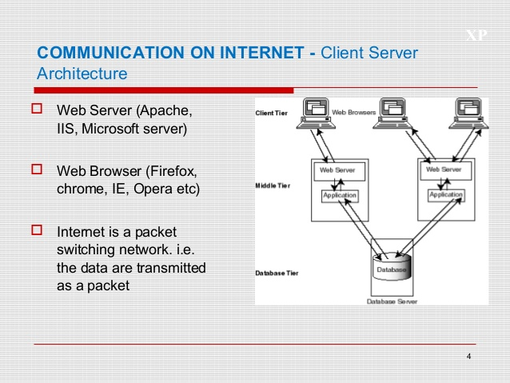
Client And Server Architecture

